Slide 1

The Ageing Process

Slide 2

Purpose & Goals
TO pass on and share knowledge regarding the functionality of the Ageing Process
For you to gain a solid understanding of the Ageing Process in order to better analyze potential solutions or problems
For you to know what, how To use, and where to find the different functionalities associated with the Ageing Process

Slide 3
The Ageing Process
Part 1

Slide 4
The Ageing Process
What Is It?
The Ageing process is a series of steps (or stages) the customer can be put through when their invoice reaches its due date.
If the customer provides a payment, then they will be removed from the aging process. If the customer does not pay their invoice, then it is possible for their account to be suspended: the system will not generate any more invoices
Notes:
‘Removed from the aging process’ – this means that they go back to a status of active, they are no longer considered by the system for any of the steps in the aging process (unless they miss another due date on an invoice, then they would start the process all over again!)
Also mention that the aging process affects the STATUS of a customer, so that a billing administrator can always see what stage a customer is in through this field. The status is linked to the aging process.

Slide 5
Ageing:
Why do we need it?
The ageing process in an important step in the billing lifecycle. Many companies need an automated way of getting their invoices reconciled.
The Aging Process tells a billing administrator where a customer stands in their company.
Aging helps the company know and understand how much money they expect, or stand to lose per month in revenue
Notes:
In addition: at a certain stage, the aging process might be involved in letting a company know which customers should be sent over to a collection’s agency.
The next slide is an example of the third point….

Slide 6
Ageing:
EXAMPLE:
Age of balances table
Invoice | 0 – 30 days | 31 – 60 days | 61 – 90 days
8232 | 40
8372 |  | 30
8323 | 20
8434 |  |  | 50
Total | 60 | 30 | 50
Notes:
This is an example of an age of balances table. It lets the company know how much is left to be paid by customers. This is important because they can guess, due to how old an outstanding payment is, how likely they are to receive the payment.

Slide 7
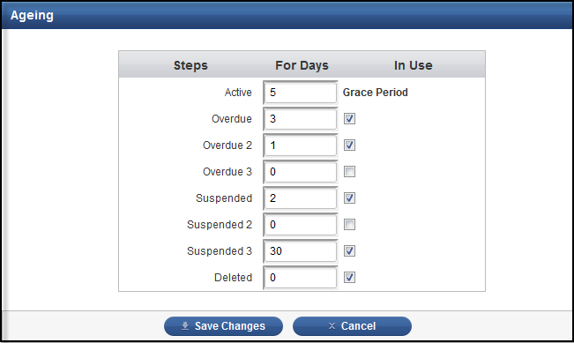
Functionality:
Existing Functionality:
The system will wait this number of days before moving to the first step
Notifications will be sent for overdue invoices based on the entered number of ‘For Days’
The customer account will become suspended and they will notifications
The customer account will be deleted
Notes:
Events that relate to the ageing process:
An invoice is overdue because it’s due date is past
The grace period gives the customer a few more days before any action is taken
After the grace period is over, the ageing steps are applied, depending on which ones you’ve configured.
Grace period – invoice is over due. The customer is still active at this point.
5. OVERDUE: A customers has failed to submit a payment before the due date. The customers will receive emails containing a text you will have selected and at a frequency of your choice (see example bellow). Other than this notifications, there are no other changes in the customer account: all the purchase orders remain exactly the same.
6. SUSPENDED: Once a customer’s account is suspended, the system will update all the customer’s active purchase orders to ‘suspended’ status, and therefore stop generating invoices for this account. The system also sends a notification to the customer.
7. DELETED: At this stage, a customer’s account is deleted from the system. For obvious reasons, you have to be careful when using this step. Normally, you will only use this ageing step when you are sure a customer will not pay her invoices and you just want to remove her account from the system.
To activate any of the steps, you would select the flag beside it, and enter the number of ‘for days’ which indicates how long the customer will remain in that stage.
5 days – will be in grace period (nothing will happen)
3 days – will become over due and stay in OVERDUE for 3 days. Another notification will be sent after those three days – move to overdue 2 = stay there for One day.
2 Days – moves to suspended after that and will stay in this stage for 2 days. After that, will go to suspended 3 for 30 days.
0 Days – after the 30 days, the customer will be deleted.

Slide 8
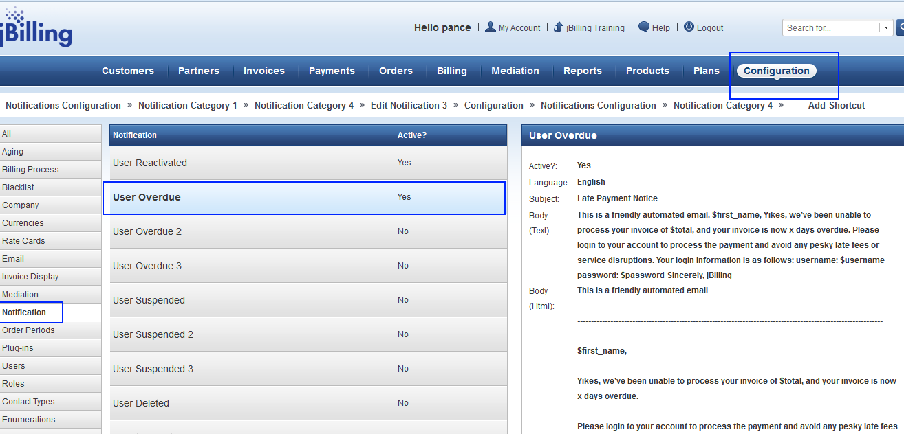
Notification:
Notes:
Along with the set up of the step name, and duration, you can configure a notification to be sent when the customer reaches that step in the aging process.
Each of the pre-configured steps has corresponding notification to be sent when the user reaches that step

Slide 9
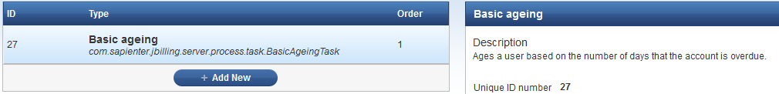
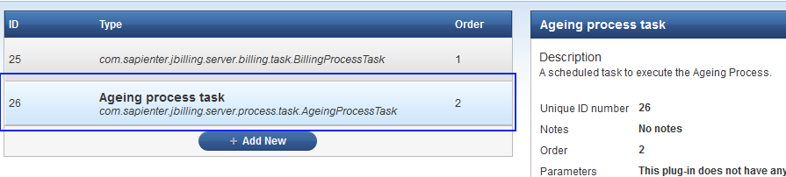
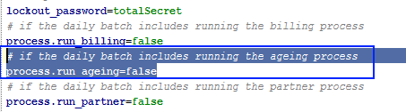
Configuration
Scheduler:
Notes:
Ageing logic is configurable by the ageing plugin. Ageing plugin can be found in the plugin category Id: 24.: Ageing for customers with overdue invoices
Currently there are 2 implementation of the ageing process:
BasicAgeingTask (basic ageing process) – contains methods for ageing user and removing the user out of the ageing process
BusinessDayAgeingTask - extends the basic ageing process and only consider business days when moving from one ageing step to another.
Scheduling the ageing is done with a scheduled task. The ageing process runs on the intervals determined by the scheduled task or in the jbilling.properties file. (if no parameters are set for the ageing scheduler)
Ageing step has to be first enabled(via a property) from the jbilling.properties file:
# if the daily batch includes running the ageing process
process.run_ageing=false

Slide 10
Functionality:
What’s new in JB 3.3?
New functionality has been developed:
Configure any number of steps in the process (unlimited)
Configure a notification to be sent along with a step
Trigger an automatic payment with a step
You still have the ability to suspend a customer’s account
Notes:
The ability to delete the customer from the system has been removed. The reason for this is because once the customer is deleted from the system, it is impossible to get the customer back through the UI. In fact, it’s also very difficult for a developer to bring the customer back. Therefore, to prevent this issue from happening, it does not exist anymore.

Slide 11
Setup:
How does it work?
Ageing step is activated if invoice is not paid and due_date + step.days = current date
The aging process can be configured by creating:
Any number of Steps
Setting how many days the customer remains in that step
Notification
Payment (to be triggered)
If the stage suspends the customer
Notes:
The aging process is triggered if an invoice is not paid, and its due date plus the step dates is the same as the current date. The step becomes ‘Activated’.
Ageing step is activated if invoice is not paid and due_date + step.days = current date
The next slides are going to break down how each of these points are configured.

Slide 12
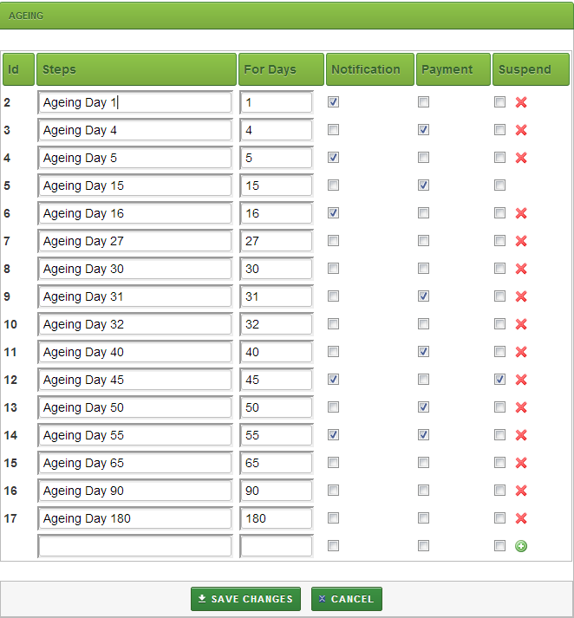
Aging Steps:
Notes:
The aging steps define how many stages you want to put the customer through in the aging process.
As you create these steps, the ‘Status’ on the customer screen will adapt to match. (possibly switch to jBilling to show the example)
The new functionality allow a billing admin to name, and configure as many steps as are required in their aging process. This makes things much more flexible. As you can see in the example, we have called them ‘Aging Day 1’, and so on, but you could name it ‘Grace period’, ‘Overdue’, ‘and so on. Or, you could have completely different names altogether.
(Click for animation) To add a new step, click on the green plus sign button.
(Click for animation) To delete any step, click on the red x.
One last point – this field is required. (STRING)

Slide 13
For Days:
Notes:
The for days field indicates how many days you want to keep the customer in that ‘STEP’ (the corresponding step located in the same row) for. This can be configured to any number of days for any stage.
Example: Aging Day 1 could be 20 days instead of 1, and so on. The configuration is always depended on the requirement of the company.
This is a required field.

Slide 14
Notification:
Notes:
Along with the set up of the step name, and duration, you can configure a notification to be sent when the customer reaches that step in the aging process.

Slide 15
Notification:
These notifications are managed by the UserAgeingnotificationtask plug-in (under Generic Internal events listener)
Parameters:
Ageing Step ID
2. Notification ID
Notes:
SHOW EXAMPLE IN THE SYSTEM!!
With the set up of the step name, and duration, you can configure a notification to be sent when the customer reaches that step in the aging process.
You need to set the parameters to match the Ageing step you want to trigger the notification on, and the notification you want to send when the customer reaches that step (ID’s entered for both parameters)
3. During the aging process, if the user is ages to a specific ageing step, the system will first check to see if the notification is enabled for that step, and if it is, the system will try to look for a matching notification ID in the UserAgeingNotifciationTask plugin parameters and will send that notification.

Slide 16
Payment:
Notes:
The payment option used to be available on the billing process configuration screen in the Number of Retries and Number of Days between retries fields. These were not flexible enough to accommodate the needs of our billing administrators.
This is why the payment has been moved to the aging process screen (as it does correspond to the aging process). You can now configure as many payment retries as needed, along with the number of days between those retries.
If you want the system to trigger a payment via the payment gateway to try and get the remaining balance from the customer, then you would select the payment checkbox in the appropriate row. You do not need to check this box at all, or for every step. Only when you want the system to trigger a payment via a payment gateway.

Slide 17
Suspend:
Notes:
The suspend checkbox allows you to tell the system when to suspend the customer’s account during the aging process.
Suspending the customer’s account means that the system will no longer generate any invoices for that customer. This is done automatically. When the customer reaches the step where the suspend checkbox is marked, the system changes all of the customer’s purchase orders to ‘SuspendAuto’. Because the customer has no active orders, the billing process will not generate any invoices.
Once the customer pays the remaining balance they owe, the system will change all the customer’s orders back to ‘Active’
You should only set 1 suspend status in the aging process.

Slide 18
Remember:
Ensure you save your changes to the ageing process before leaving that screen.
You also still need to configure the Agringprocesstask plug in under Scheduled plug-ins.
Notes:
LAST SLIDE IN PRESENTATION
#2: Also applies to both the existing and new functionality!! Don’t forget to mention this

Slide 19
Late Fee:
When a user reaches a pre-determined step in the ageing process a Late fee can be automatically generated
The Late fee will be applied to the overdue invoice

Slide 20
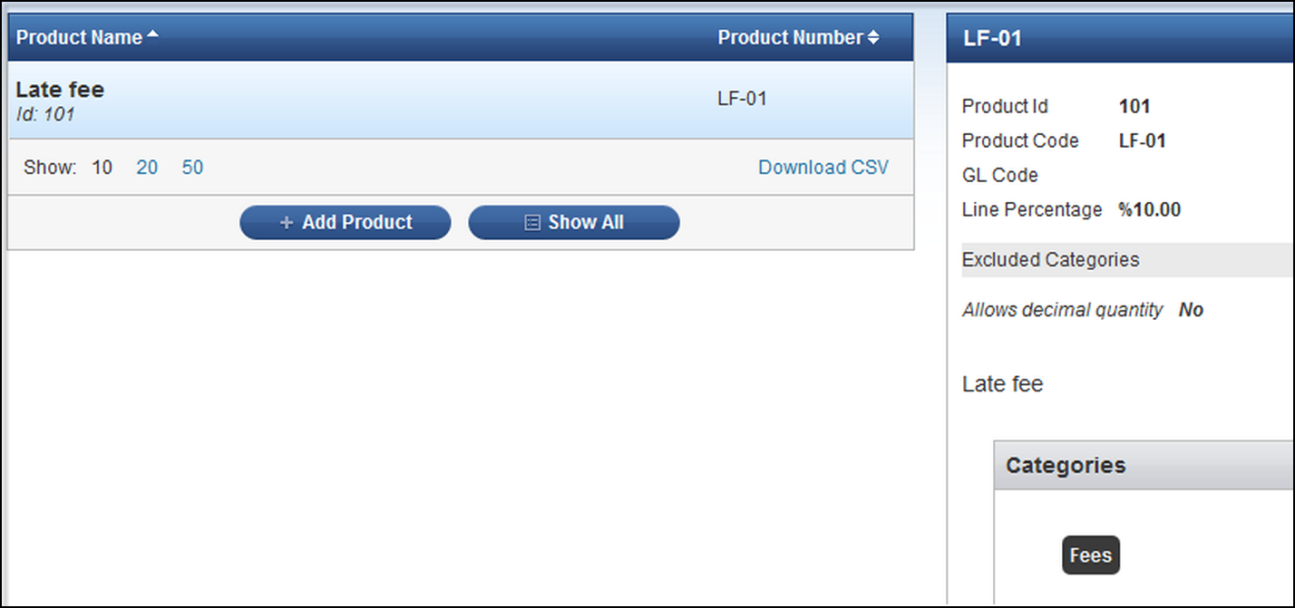
Late Fee:
Notes:
Steps to create:
1. Create the late fee product in jBilling – remember the ID number! The late fee can be either a percentage or a regular rate.

Slide 21
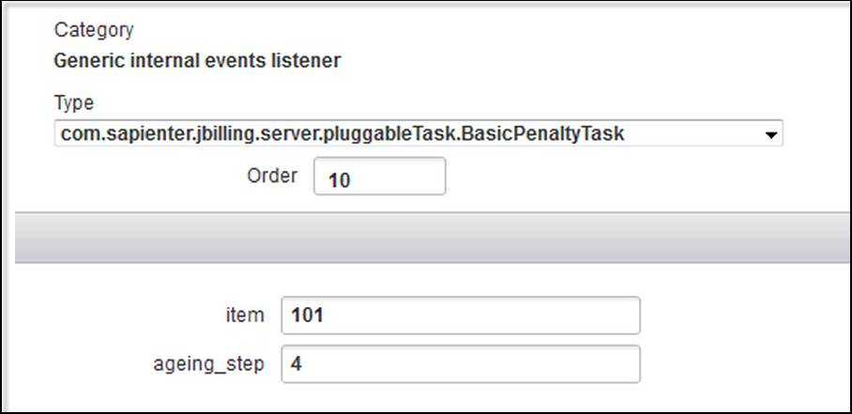
Late Fee:
Configure: BasicPenaltyTAsk
Configuration > Plug-Ins > Generic Internal Events Listener
Notes:
Step 2: configure the BasicPenaltyTask Plug-in
(CLICK FOR ANIMATION) ITEM: is the ID number of the product you created earlier, the late fee product
(CLICK FOR ANIMATION) Ageing Step: the ageing step for which you want the fee to be applied on
For Example:
The customer, during the ageing process can be moved to a particular ageing step (Overdue, Overdue2 etc).
If the ageing step ID to which the customer is assigned corresponds to the ageing step configured in the BasicPenaltyTask plugin, then a one time order is created with the late penalty fee product and that one time order is immediately applied to the customer's overdue invoice.
The customer will now pay the invoice amended with the late fee amount. (TRY TO SHOW AN EXAMPLE OF THIS IN THE SYSTEM)

Slide 22
Remember:
Configure ageing steps and notifications
Configure ageing scheduler
Configure ageing process plugin
Configure late fee applied to particular ageing step(optional)
Enable ageing process in the jbilling.properties
Notes:
LAST SLIDE IN PRESENTATION

